Slide 1
Project Presentation of Industry Oriented Hands on Experience (22CS422)
On
WasteChain: A Smart Recycling Traceability and Analytics Platform
Supervised By
Dr. Monika Aggarwal
Department of Computer Science and Engineering,
Chitkara University, Punjab
Pushpinder Singh
Narinder Singh
Lokesh Vaid
Nipun Kumar
2210990693
2210990598
2210990545
2210990615

Slide 2
Introduction
Introduction
Recycling seems easy, but the process is not well organized. Citizens depend on local vendors for waste collection, but pickup schedules are irregular and inconsistent. Sometimes waste is collected on time, and sometimes it is delayed.
Collectors also face problems because there is no proper system to track requests and manage work. Most activities are done manually, which reduces transparency and efficiency.
Recyclers do not get proper information about recyclable waste. Poor record management and lack of tracking create delays and confusion. Existing systems solve only a few problems and do not provide complete waste tracking or smart automation.
2

Slide 3
Problem Statement
Existing Issues
Recycling systems are unorganized and difficult to manage.
Citizens depend on local vendors with random pickup schedules.
Waste collection is inconsistent and lacks reliability.
Collectors face problems in tracking requests and managing workflows.
Most operations are handled manually with low transparency.
Recyclers do not get proper visibility of incoming recyclable waste.
3

Slide 4
Objective
Main Objectives
To develop a smart and efficient recyclable waste management system.
To provide proper waste traceability from collection to recycling.
To enable real-time tracking and monitoring of recyclable waste.
To create a structured workflow for citizens, collectors, and recyclers.
To use data-driven analytics for better decision-making and waste management.
To promote sustainable and eco-friendly recycling practices.
4

Slide 5
System Architecture / Modules
User Module: Citizens submit recyclable waste pickup requests through the application.
Collector Module: Collectors receive requests, manage pickups, and update waste status.
Scrap Dealer Module: Scrap dealers collect and process recyclable materials from collectors.
Database Server: Stores user data, pickup details, waste records, and transaction history.
Analytics Dashboard: Monitors waste movement, recycling statistics, and system performance using real-time data.
5

Slide 6
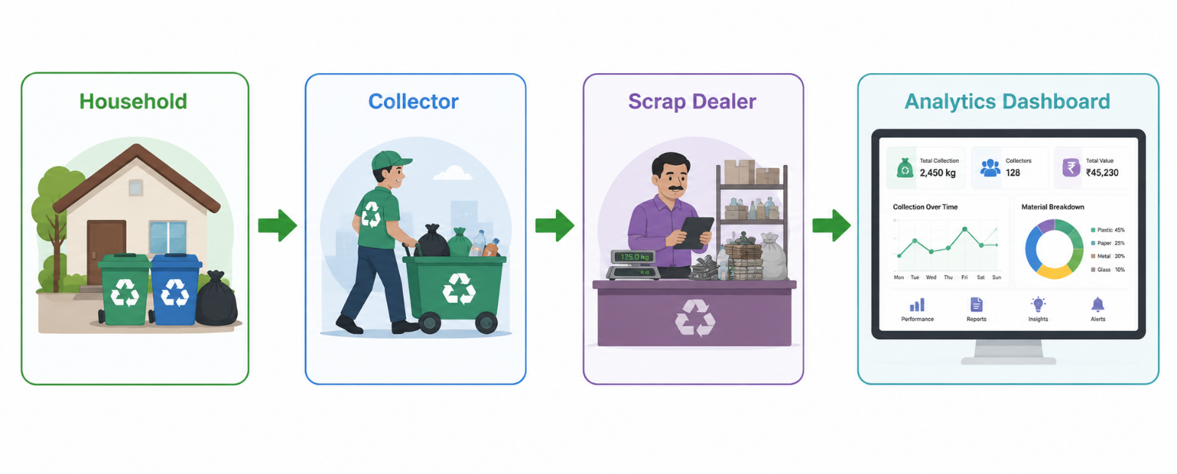
System Architecture / Modules
Admin Module: Manages users, monitors activities, and ensures smooth system operation.
Notification System: Sends pickup updates, alerts, and status notifications to users and collectors.
6

Slide 7
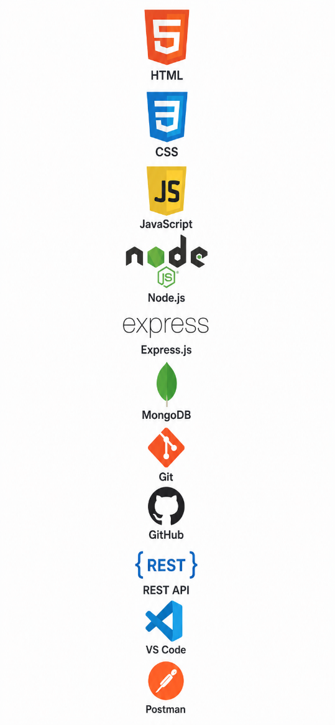
Technologies Used
Frontend: React + vite
Backend: Node.js / Express.js
Database: MongoDB
Cloud Services: Cloudnary
Authentication: Json Web Token
Data Visualization: Chart.js / Analytics Dashboard
Version Control: Git & GitHub
APIs: REST API for communication between modules
7

Slide 8
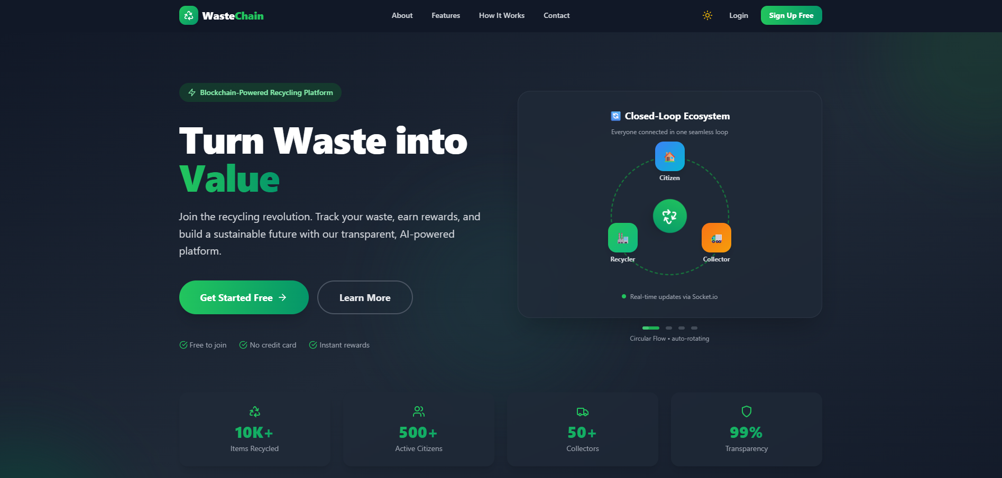
Result / Output
Homepage
8

Slide 9
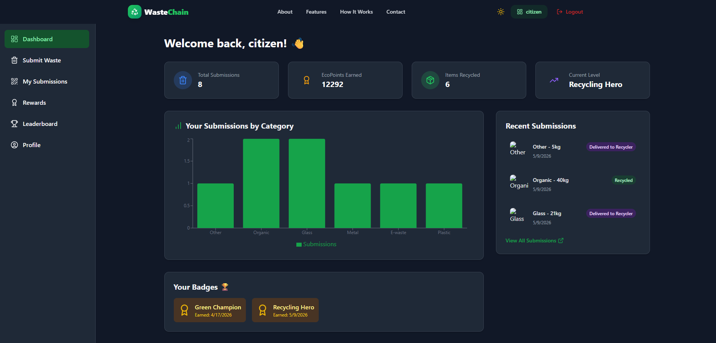
Result / Output
Citizen Dashboard
9

Slide 10
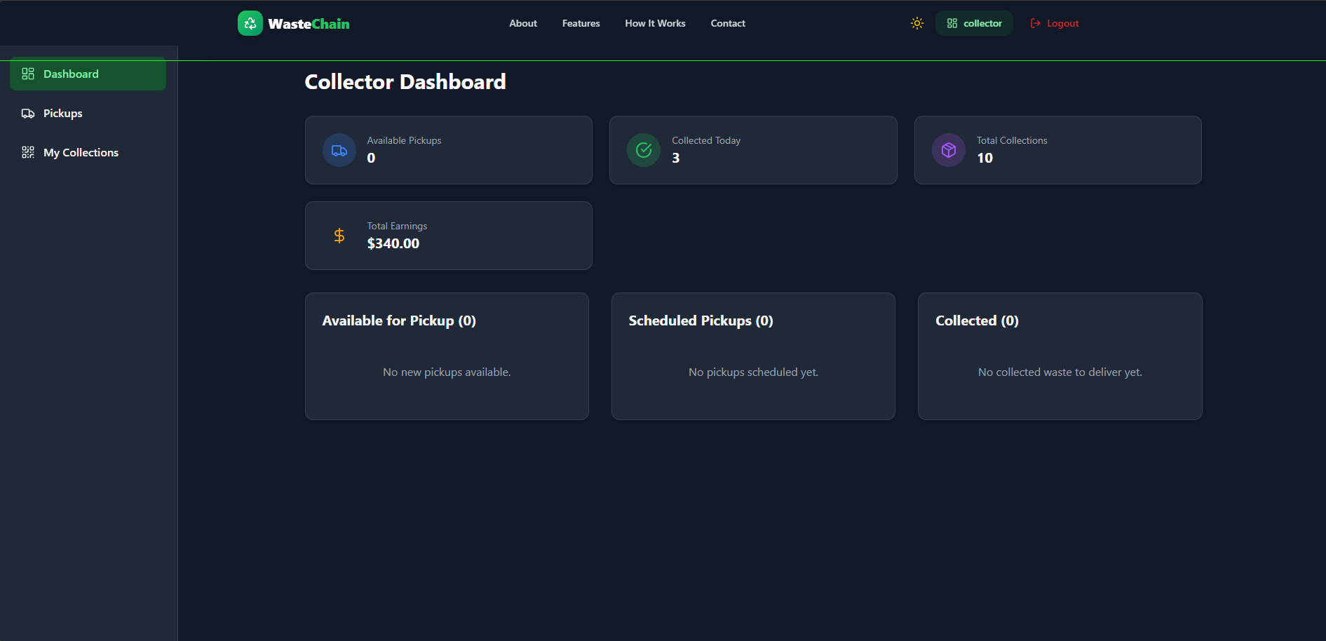
Result / Output
Collector Dashboard
10

Slide 11
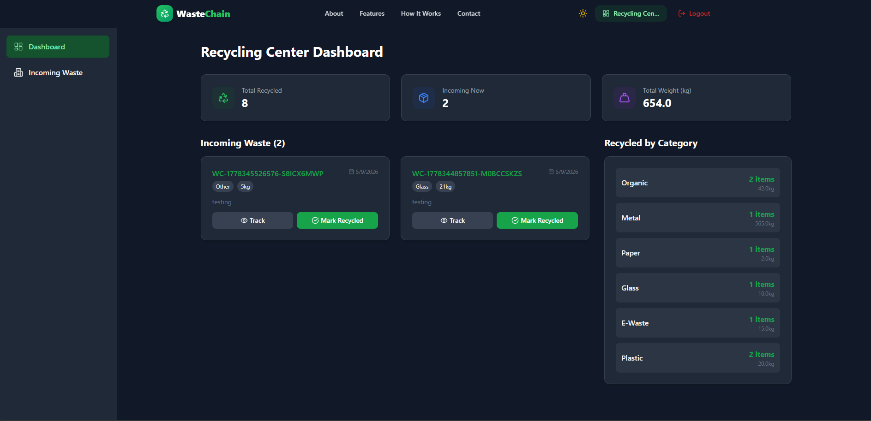
Result / Output
Recycler Dashboard
11

Slide 12
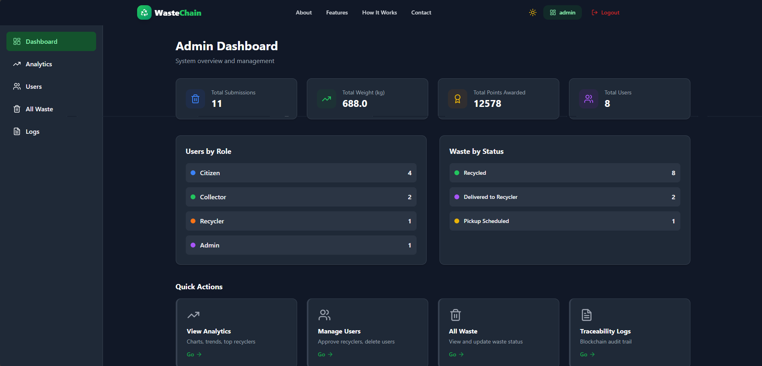
Result / Output
Admin Dashboard
12

Slide 13
Future Scope
Integration of AI and Machine Learning for smart waste prediction and classification.
Implementation of IoT sensors for real-time waste monitoring and tracking.
Addition of GPS-based route optimization for collectors.
Development of reward systems to encourage citizens for recycling participation.
Integration with government waste management platforms for better transparency.
Advanced analytics and reporting for efficient decision-making and sustainability planning.
13

Slide 14
Conslusion
Conclusion
The proposed recyclable waste management system provides a smart and efficient solution for handling recyclable waste. It improves waste traceability, transparency, and recycling management through digital monitoring and data-driven analytics. The system reduces manual coordination, enhances workflow efficiency, and supports sustainable environmental practices. Overall, the project helps create a more organized, reliable, and eco-friendly recycling process.
14

Slide 15
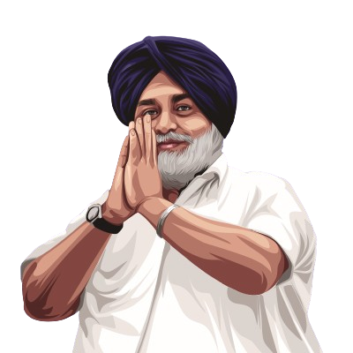
Thank You
15

